Slide 1

Rice feeds over half the world
Notes:
Context Setting: Begin by discussing the global significance of rice as a staple crop, feeding over half the world's population.

Slide 2
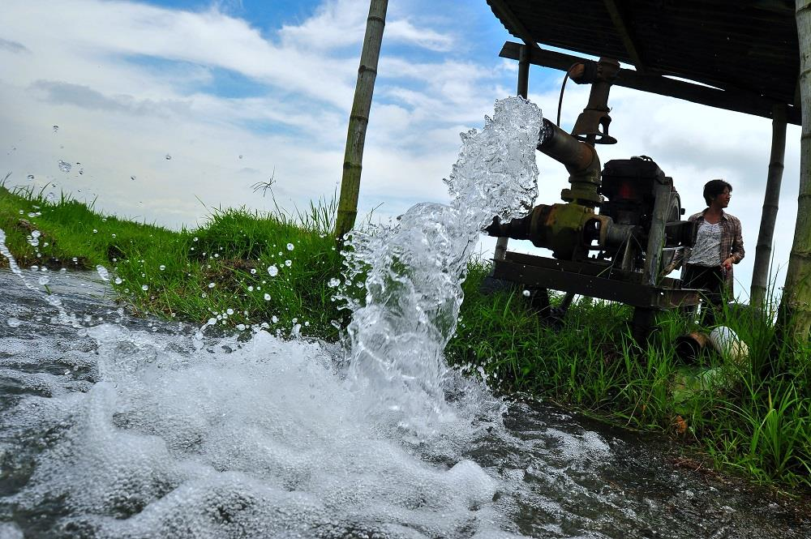
Concern about the future of rice
Economic shifts, urbanization, climate change, greenhouse gas, water scarcity, soil health
Notes:
Economic shifts, Urbanization, Climate change, Greenhouse gas, Water scarcity, Soil Health

Slide 3
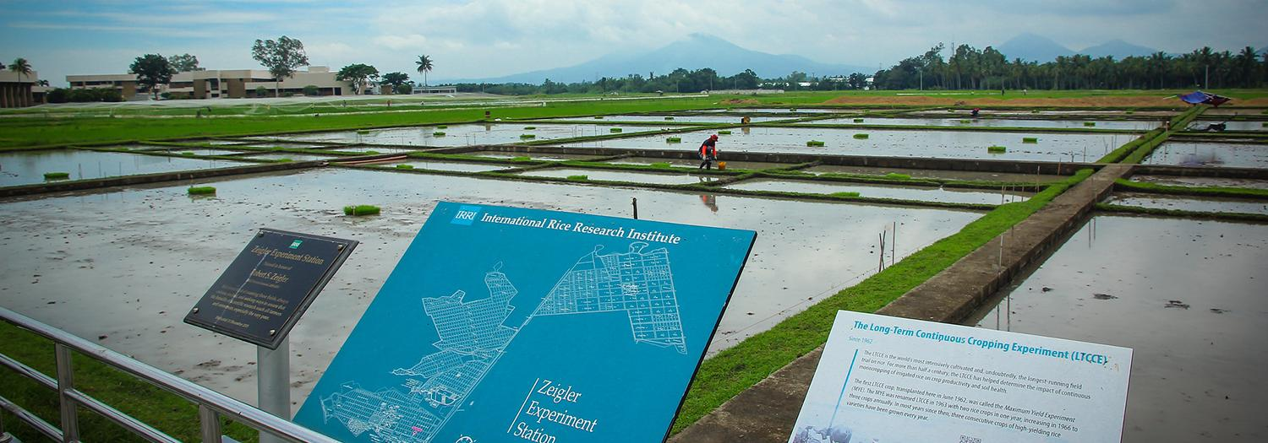


Long-term experiments in IRRI
K Saito
O Angeles

Slide 4
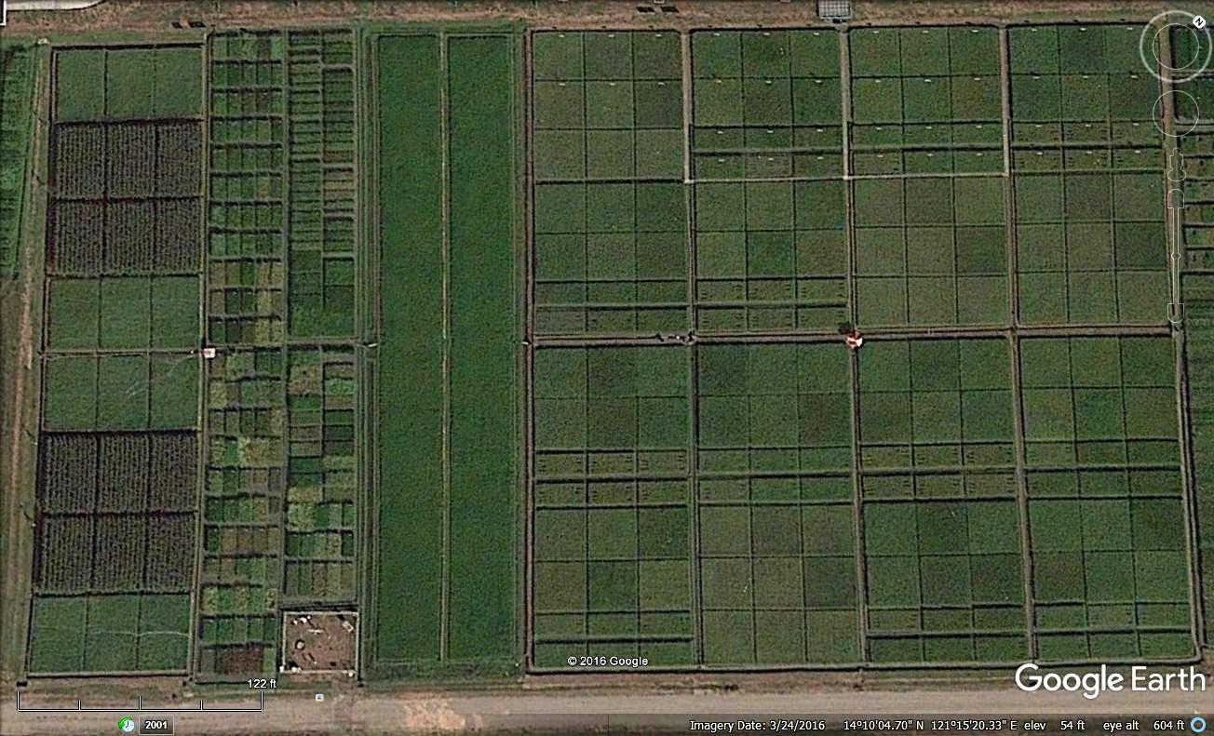
1962: Long term continuous cropping experiment (LTCCE) – 179 seasons
1993: Rice-upland crop rotation experiment (B2)
Rice-Upland
Crop (maize)
Rotation
Experiment
(2 crops
per year)
Long Term Continuous Cropping Experiment
(3 rice crops per year)
Weather Station

Slide 6
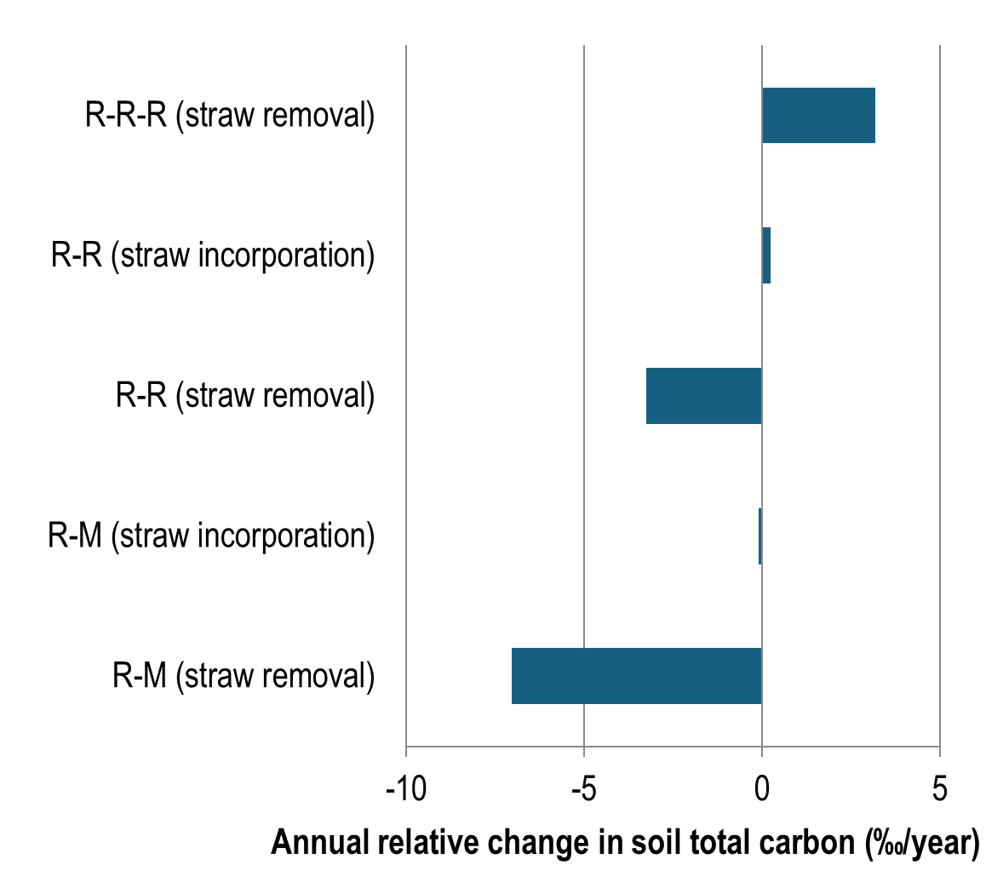

Slide 7
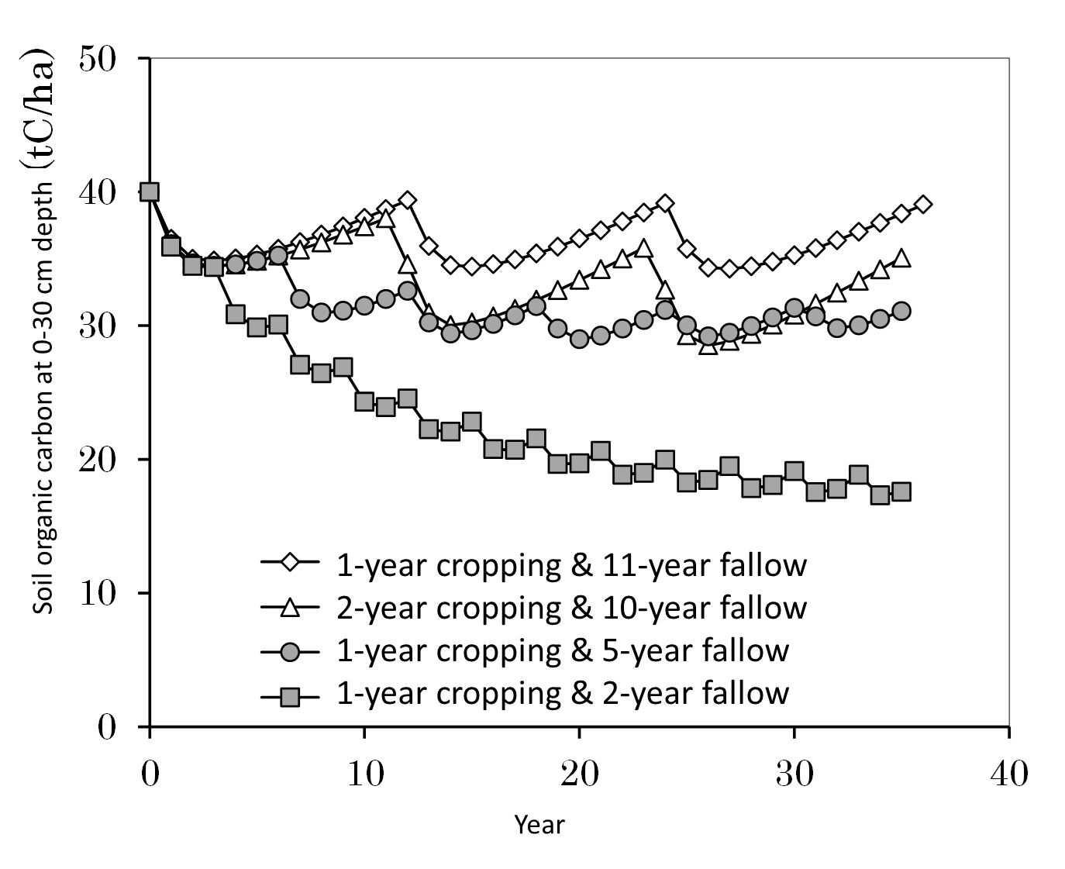
Sustainability of other systems
Rainfed rice/fallow in dry season reduced SOC stocks, whereas rice-rice and rice-maize systems maintained them.
Short-term fallow upland rice systems did not maintain yield and SOC.
Simulation on impact of land use on soil organic carbon (SOC) stocks in slash-and-burn in Laos.
(Wit et al., 2000; Pampolino et al., 2007; Saito & Asai, 2015; Cha-un et al. 2017)

Slide 8
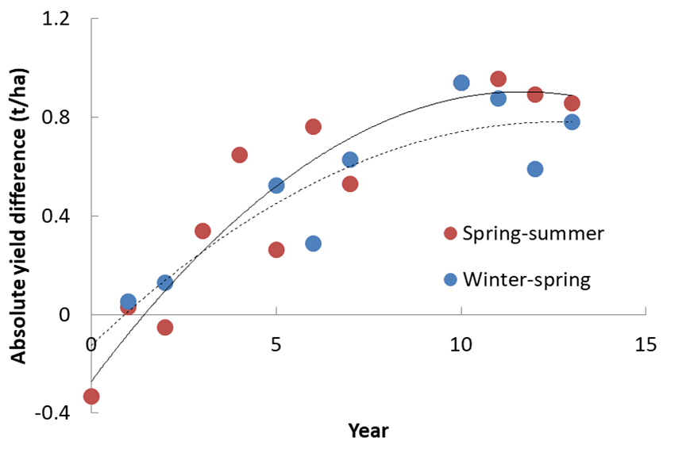
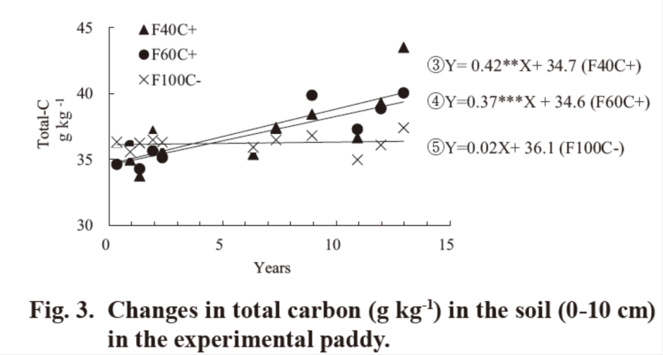
Long-term impact of compost in Vietnam
(Watanabe et al., 2009, 2013, 2017)
Started in 2000 and on-going (2 seasons per year)
Control: NPK without rice compost (F100C-)
Treatment: 60% NPK with compost (6t/ha) (F60C+)
Finding: compost can replace NPK, and improve rice yield and soil carbon.

Slide 9
Thank you for your listening

Slide 11
Determine the effect of continuous triple rice cropping on trends in crop productivity and sustainability of rice production
Assess the effect of continuous triple rice cropping on soil parameters and trends in indigenous N supplying capacity, as determined from the yield and N uptake of rice in plots receiving no N fertilizer
Assess the long term trends in the gap between potential yields, as determined by germplasm and climate conditions, and the actual attained yield
Determine the trends in N response and N use efficiencies as affected by variety and season.
Long term continuous cropping experiment (LTCCE)

Slide 12
Long term continuous cropping experiment (LTCCE)
Year started: 1962 early wet season
Number of crops/season: 3 crops per year
Seasons: Dry season (Jan-May)
Early wet season (June-Aug)
Late wet season (Sept-Dec)
Experimental Design: Split-split plot (1968 DS -1990 LWS)
Split plot (1991 DS – present)
Main plot: Fertilizer rates (F1-F4)
Subplot: Variety (V1-V6)
Sub sub-plot: Crop establishment (1968 DS -1990 LWS)
Replicates: 4

Slide 13
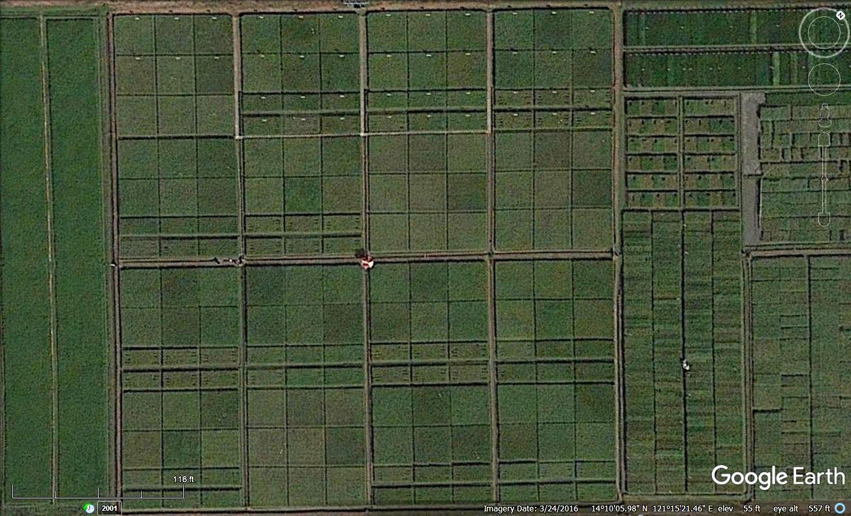
F3
F4
F1
F2
V2
V1
V3
V3
V1
V2
V1
V3
V2
V2
V1
V3
V6
V5
V4
V5
V6
V4
V5
V6
V4
V6
V4
V5
F2
F3
F4
F4
V3
V1
V2
V1
V2
V3
V3
V2
V1
V1
V3
V2
V6
V4
V5
V5
V6
V4
V5
V4
V6
V4
V6
V5
Plot size: Main plot: 25 m x 25 m = 625 m2
Sub plot size: 69.44 m2
F1
F1
F2
F3
V1
V3
V2
V1
V3
V2
V3
V1
V2
V3
V2
V1
V5
V6
V4
V4
V6
V5
V6
V4
V5
V6
V5
V4
F4
F2
F3
F1
V3
V2
V1
V3
V1
V2
V1
V3
V2
V1
V2
V3
V4
V6
V5
V6
V4
V5
V4
V6
V5
V6
V5
V4
Notes:
Historical plots

Slide 14
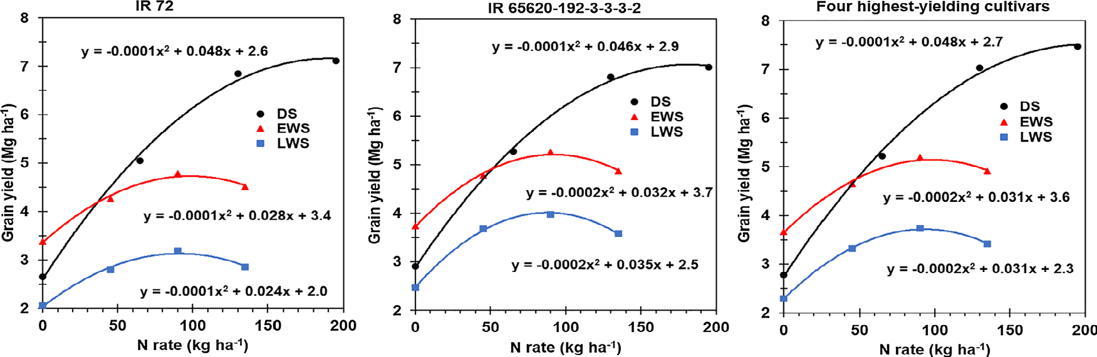
Responses of rice to N fertilizer in dry season (DS), early wet season (EWS), and late wet season (LWS) averaged from 2001–2015 for four highest-yielding cultivars (Buresh et al., 2019).

Slide 15
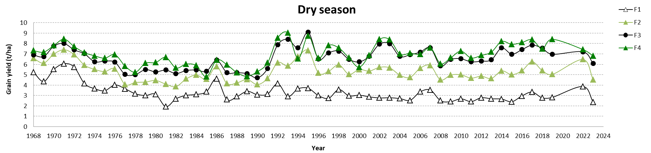
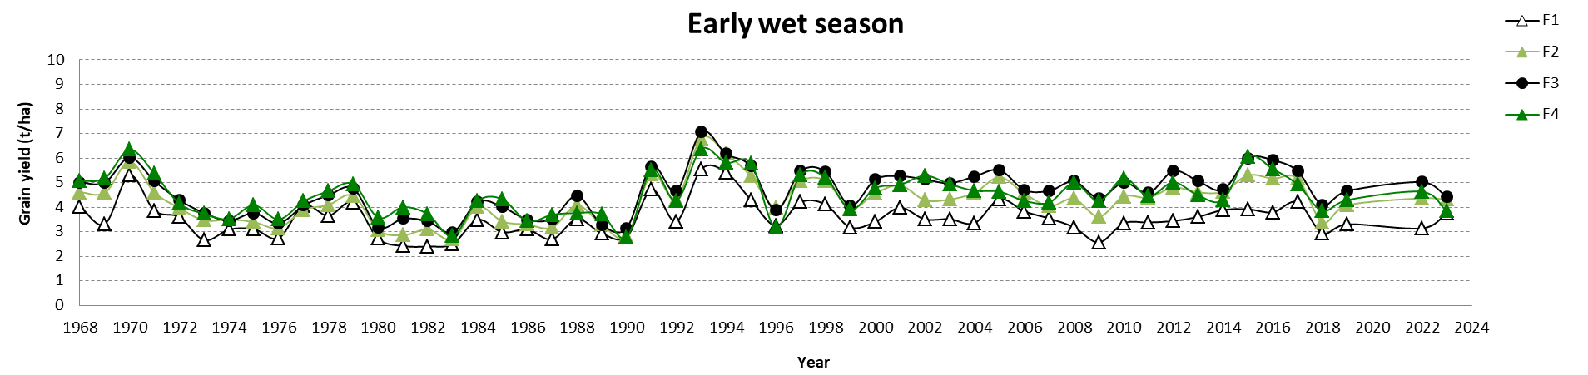
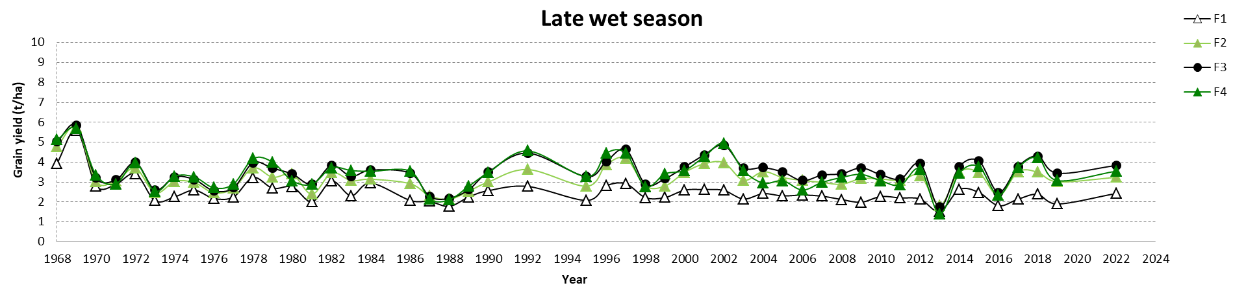

Slide 16
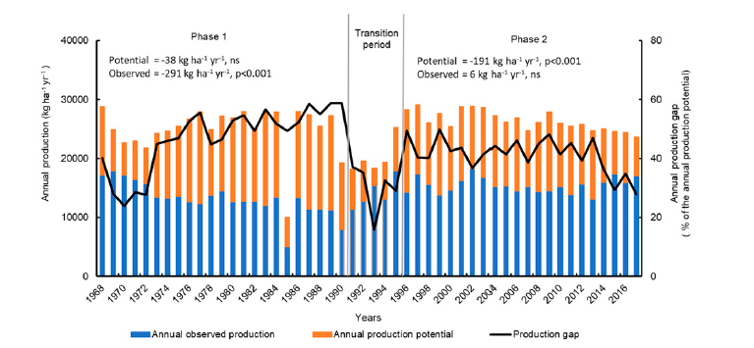
(Dobermann et al., 2000; Pampolino et al., 2008; Buresh et al., 2021; Ladha et al., 2021)

Slide 17
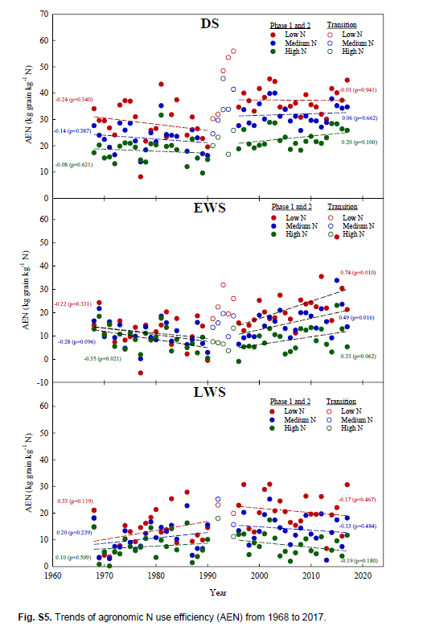

Slide 18
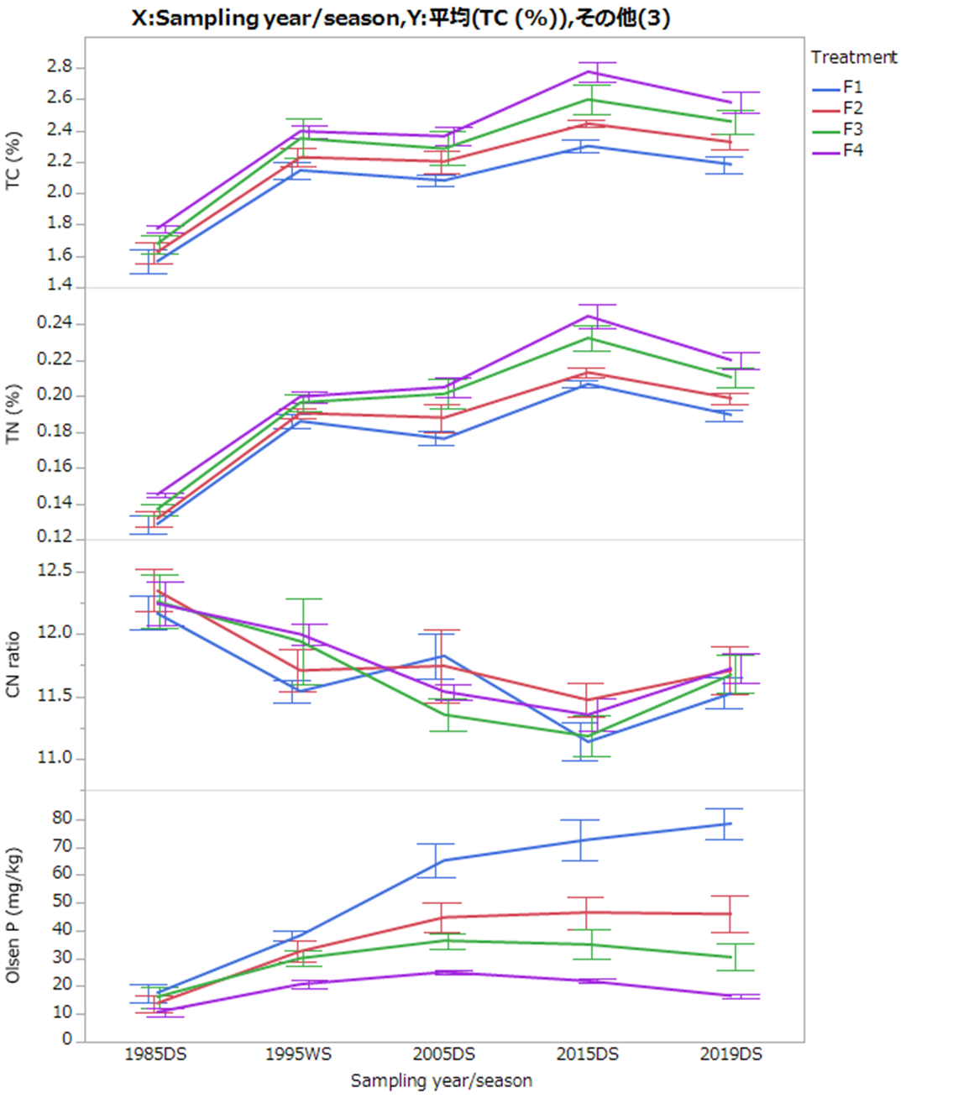
Nishigaki et al. (unpublished data)

Slide 19
Determine the effect of crop diversification from lowland flooded rice to an upland crop on soil properties and measures of soil quality including soil organic matter, mineralization and carbon balances.
Determine the effect of tillage method for maize on crop performance for maize and rice, soil properties, and SOM.
Assess the effect of straw management on growth of subsequent crops.
Assess the effects of cropping system and N fertilization on yield and nutrient balances.
B2: Rice-Maize Crop Rotation

Slide 20
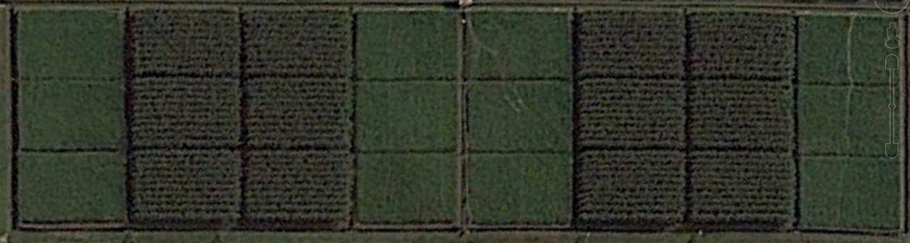
Rep 1
Rep 2
Rep 3
Rep 4
S0
S1
S0
S1
S0
S1
S0
S1
S1
S0
S1
S0
S1
S0
S1
S0
N1
N3
N1
N2
N3
N2
N1
N2
-------- P i l i D r i v e ----------
S0
S1
S0
S1
S1
S0
S1
S0
S0
S1
S1
S0
S0
N2
N1
N3
N1
N2
N1
S1
S0
S1
N3
N3
S1
S0
S1
S0
S0
S1
S0
S1
S1
S0
S0
S1
S0
N3
N2
N2
N3
N1
N3
S1
S0
S1
N2
N1
R-R
R-M
R-M
R-R
R-R
R-M
R-M
R-R
Main plot size (R-R(DS)/R-M(DS)): 22.8 m x 11.4 m = 256.5 sqm
Subplot size (Tillage in DS x N in WS) : 11.4 m x 7.6 m = 86.64 sqm
Sub subplot size (S0 – removal /S1 - incorporation): 5.7 m x 7.6 m = 43 sqm
Row spacing: Rice = 30cm x 13.5cm; Maize = 18 cm x 75 cm spacing

Slide 21
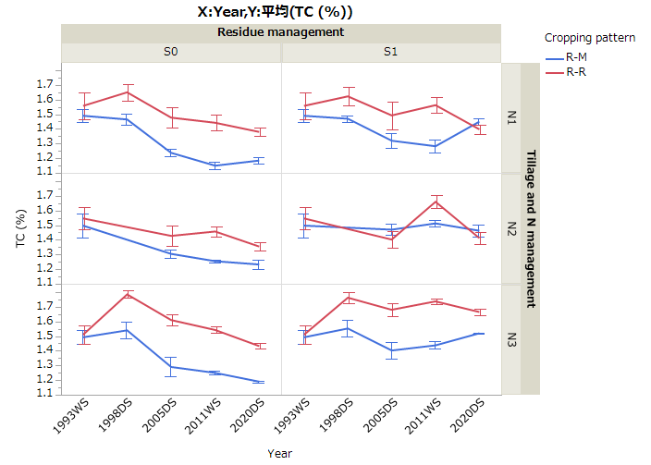
Rice and maize yield:
No or minor impact of diversification on WS rice yield
No or minor impact of residue management on crop yield
No negative impact of tillage on DS rice and maize yield
Higher GHG in WS rice following maize in DS than rice in DS (to be validated)
Soils:
Straw removal reduced total C and N (not shown).
Reduction in C was higher in R-M rotation.
Straw incorporation sustained total C and N.
On-going works :
Soil and plant analyses and additional GHG measurement. Paper writing.

