Slide 1


Logos ThaRD, ThaiNAMA
Thailand, 20th November 2023

Slide 2
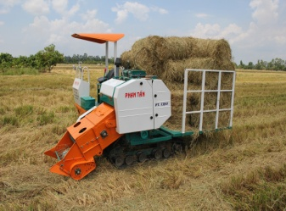
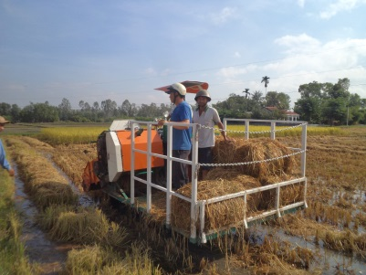
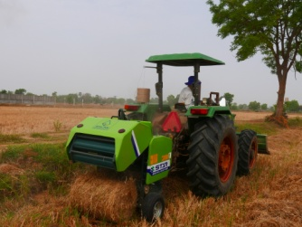
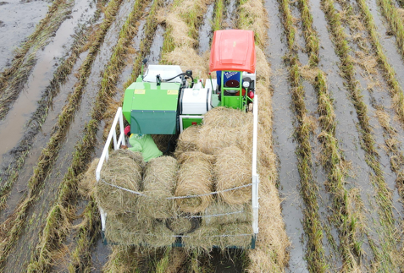

Mechanized Rice Straw Collection enables to remove rice straw from the field
Removal of rice straw for mushroom and compost / organic fertilizer production can reduce >20% of GHGe from the practice of rice straw incorporation in the wet field
Dry-field rice straw baler
Wet-field rice straw baler

Slide 3
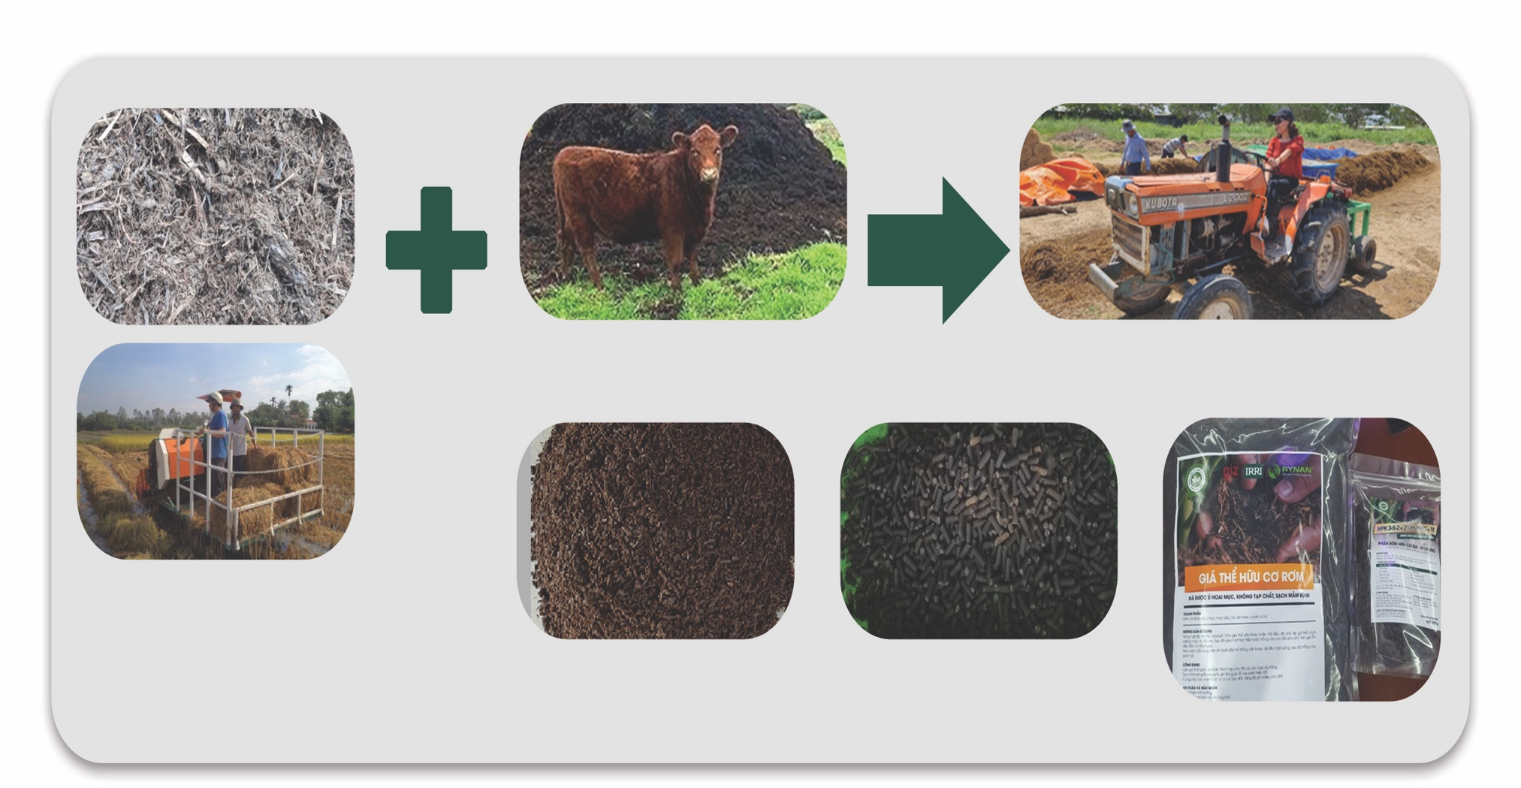

Rice straw composting – alternative to chemical use for added value and reduce environmental footprint
Physical process
Bio - chemical process
^{animal manure}
=> Optimize rice straw decomposition efficiency and organic fertilizer quality.
after-mushroom, low quality, or wet straw
^{organic fertilizer}
^{Compost pellets}
Packaged products for testing markets

Slide 4
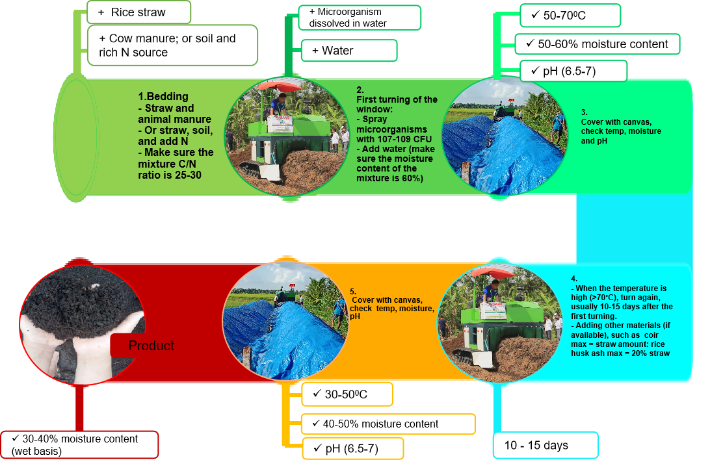
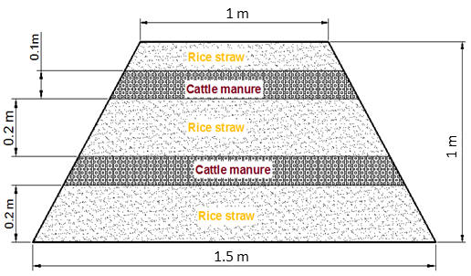
Mechanized Rice Straw - Based Composting Process

Slide 5
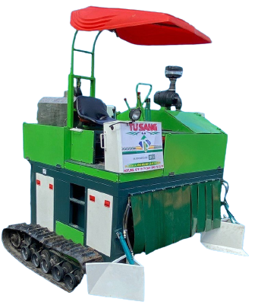
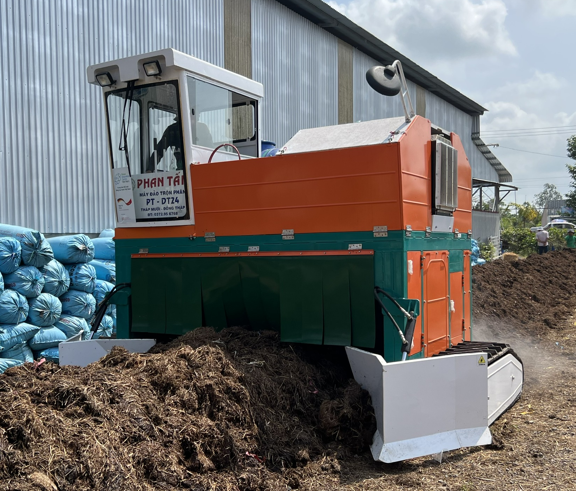
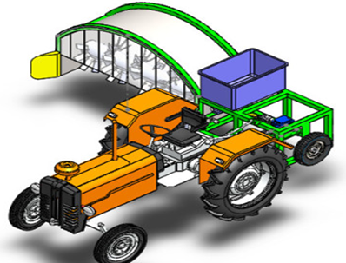
Technology Development Process of the Compost Turner
Tractor-mounted composting turner
Self-propelled composting turner
Mounted to a 30-35 HP tractor
Capacity: 25-30 tons/hour per batch
Fuel consumption: 0.1 -0.15l diesel/ton
Capacity: 183-300 m³ per batch
Fuel consumption: 0.1 -0.15l diesel/ton

Slide 6
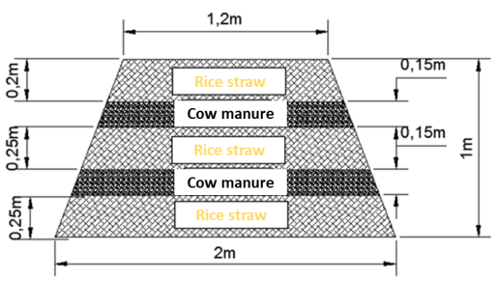
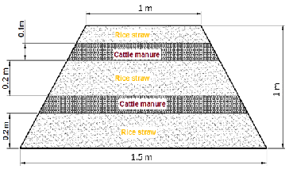
The Measurements of Windrow Rice Straw-based Composting
Layering method: depending on the height of the windrow, all input materials are added in adjustable-dimension layers (one layer of rice straw following by one layer of cow manure)

Slide 7

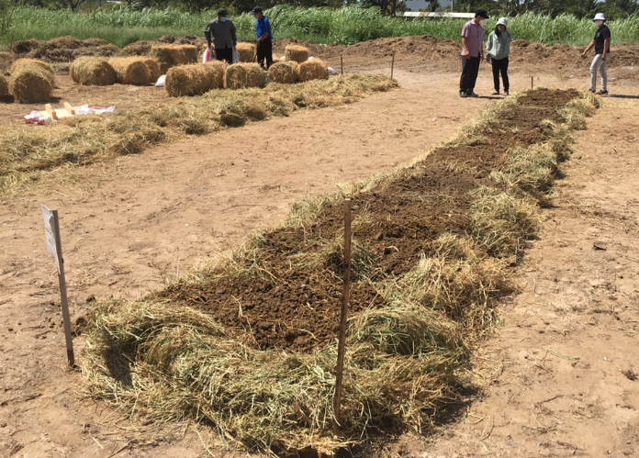
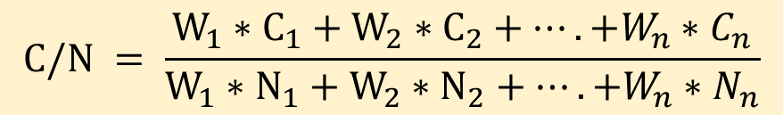
“Controlled” Factors of Composting Windrow
C/N Ratio
$$C/N = \frac{W_{1}∗C_{1}+W_{2}∗C_{2}+….+W_{n}∗C_{n}}{W_{1}∗N_{1}+W_{2}∗N_{2}+….+W_{n}∗N_{n}}$$
W₁, W₂,… W_{n} = weight of single materials
C₁, C₂, … C_{n} = organic carbon content of single materials
N₁, N₂, … N_{n}= Nitrogen content of single materials
For an optimal process, a C/N ratio in the range of 25–30 is generally recommended

Slide 8
Mixing ratio of raw materials for 10 tons finished product
Mixing case | Materials | Weight (Tons) | Moisture (%)
Case 1: Raw rice straw + Cow manure | Raw rice straw | 6 | 30%
 | Cow manure | 5 | 30%
Case 2: Rice straw after mushroom cultivation + cow manure | Rice straw after mushroom cultivation | 8 | 30%
 | Cow manure | 3 | 30%
Case 3: Raw rice straw + Soil + Urea | Raw rice straw | 5.5 | 30%
 | Soil | 5.5 | ≤ 30%
 | 50 kg Urea + 100 kg Super Phosphate + 30 kg Potassium

Slide 9

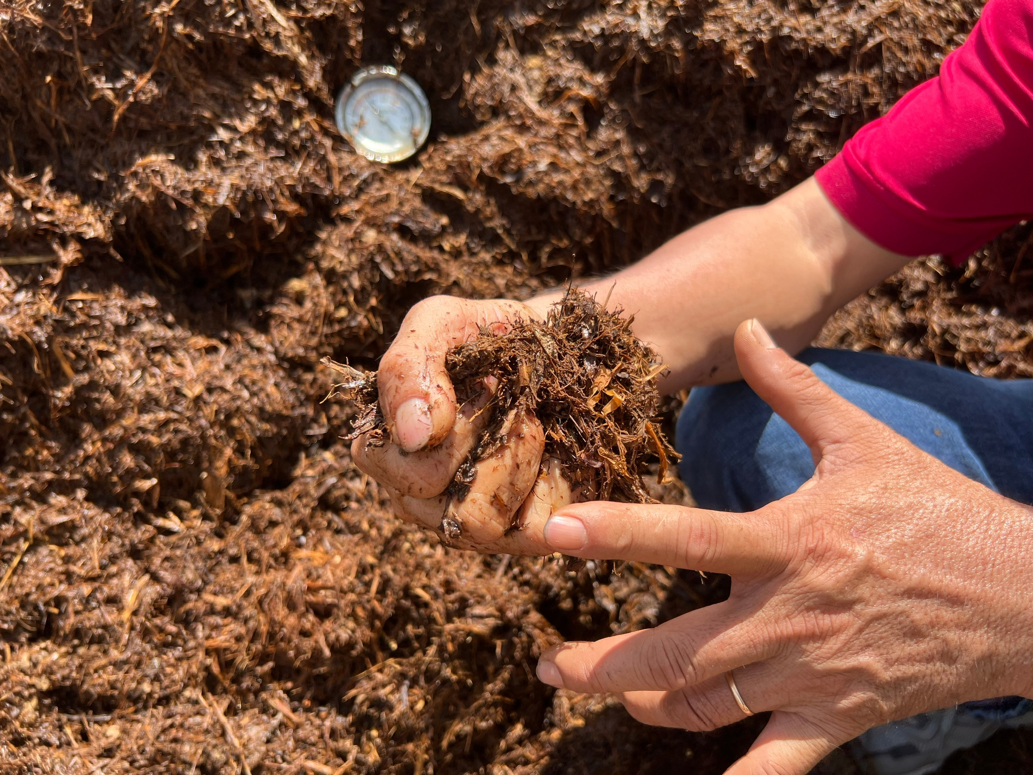
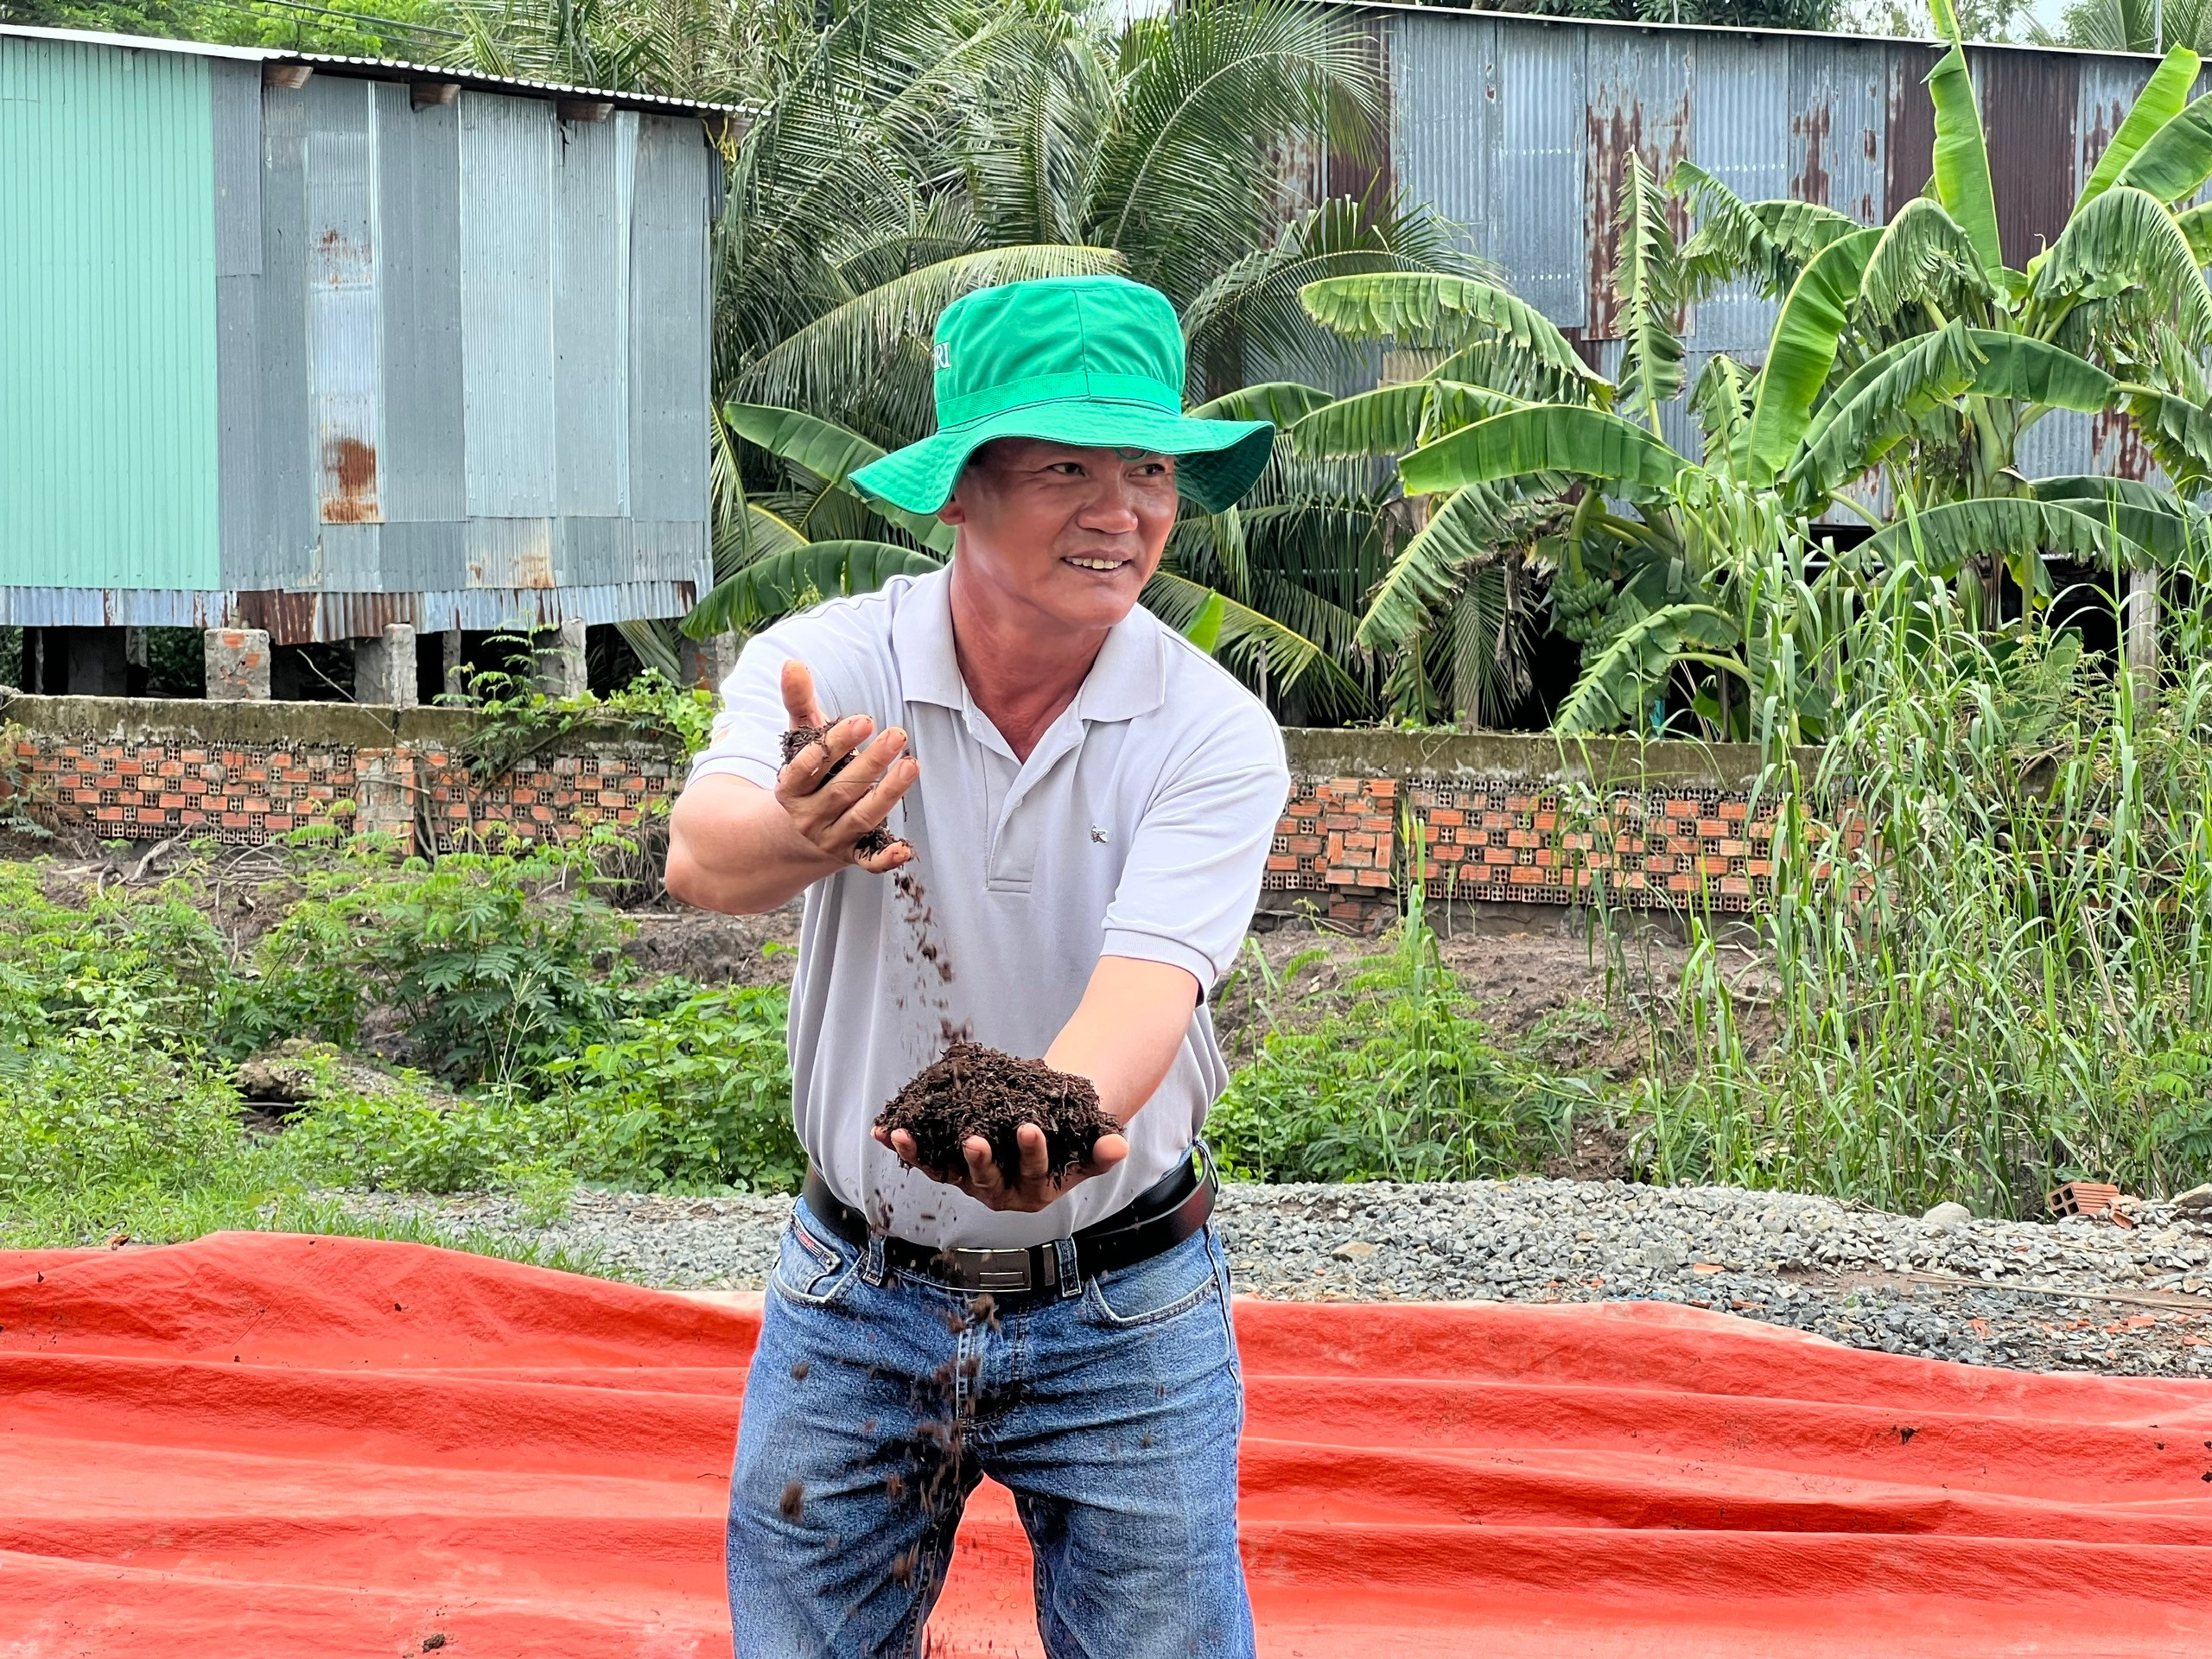
“Controlled” Factors of Composting Windrow
MOISTURE
The moisture is related to the amount of oxygen which is provided for microorganisms
MC = 60 % ==> Optimized for composting
IF MC > 65 % ➔ Lack of oxygen
➔ To reduce the decomposition process.
Moisture of the finished product => 30 %

Slide 10

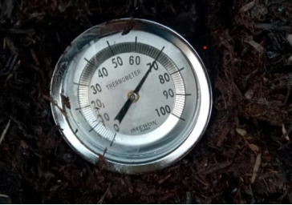
“Controlled” Factors of Composting Windrow
TEMPERATURE
Thermophilic stage lasts for 7-10 days
Cover with a canvas or tarp to restrict airflow and rainfall
When the temperature is high (>70⁰C), turn again, usually 10-15 days after the first turning

Slide 11

MECHANIZED RICE STRAW-BASED COMPOSTING VIDEO
Mechanized Rice Straw Composting (Thai Sub) - YouTube

