Slide 1


E-learning Module
APPLICATION OF MECHANIZATION IN RICE STRAW COLLECTION

Slide 2
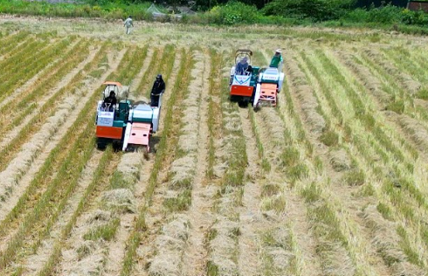
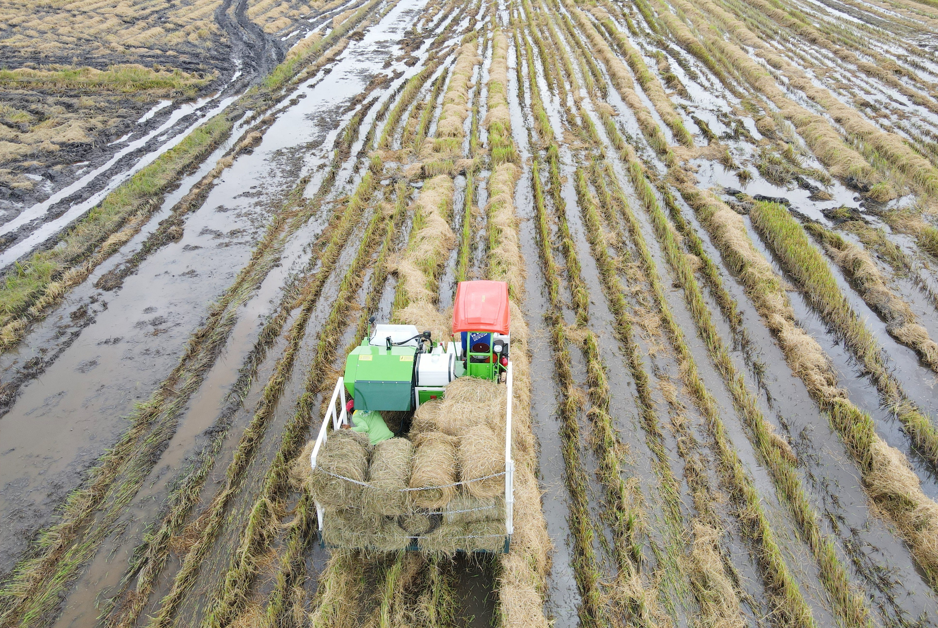
1. Rice straw collection
Rice straw can be collected on both dry or wet fields using appropriate rice straw baler. If the weather is dry, the rice straw can be dried in the field before collection. However, the straw should not be left in the field for more than 5 days after harvest to avoid quality degradation, particularly nitrogen loss. Wet rice straw after harvest should be collected immediately to prevent quality degradation due to decomposition and increased greenhouse gas emissions

Slide 3
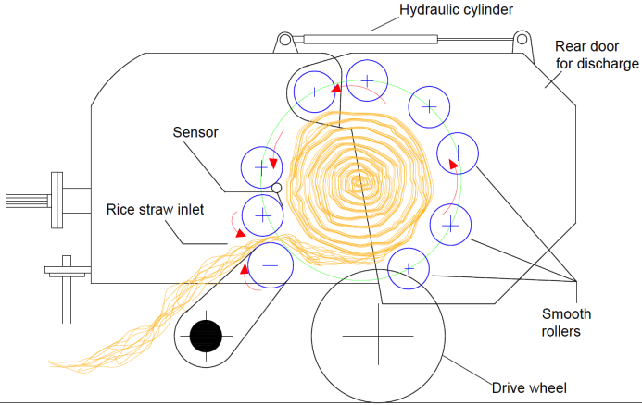
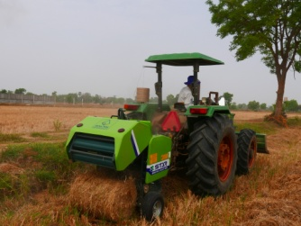
2. Application of mechanization in rice straw collection
Roller baler pulled by a tractor
Hydraulic cylinder
Rolling and releasing each bale of straw in the field requires transportation means to move the straw to a central collection point, such as the edge of the field. This type of rice straw baler machine cannot operate on wet fields because the tires easily get stuck in the mud. The straw bales released in the field will get muddy, reducing the quality of the straw
Round balers: In the compression chamber, continuously rotating rollers compress the straw into cylindrical bales. The machine has pauses during operation to tie the twine and eject the bales

Slide 4
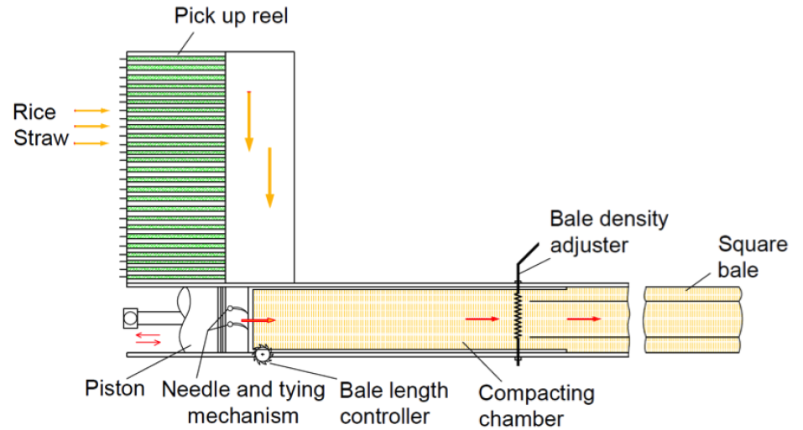
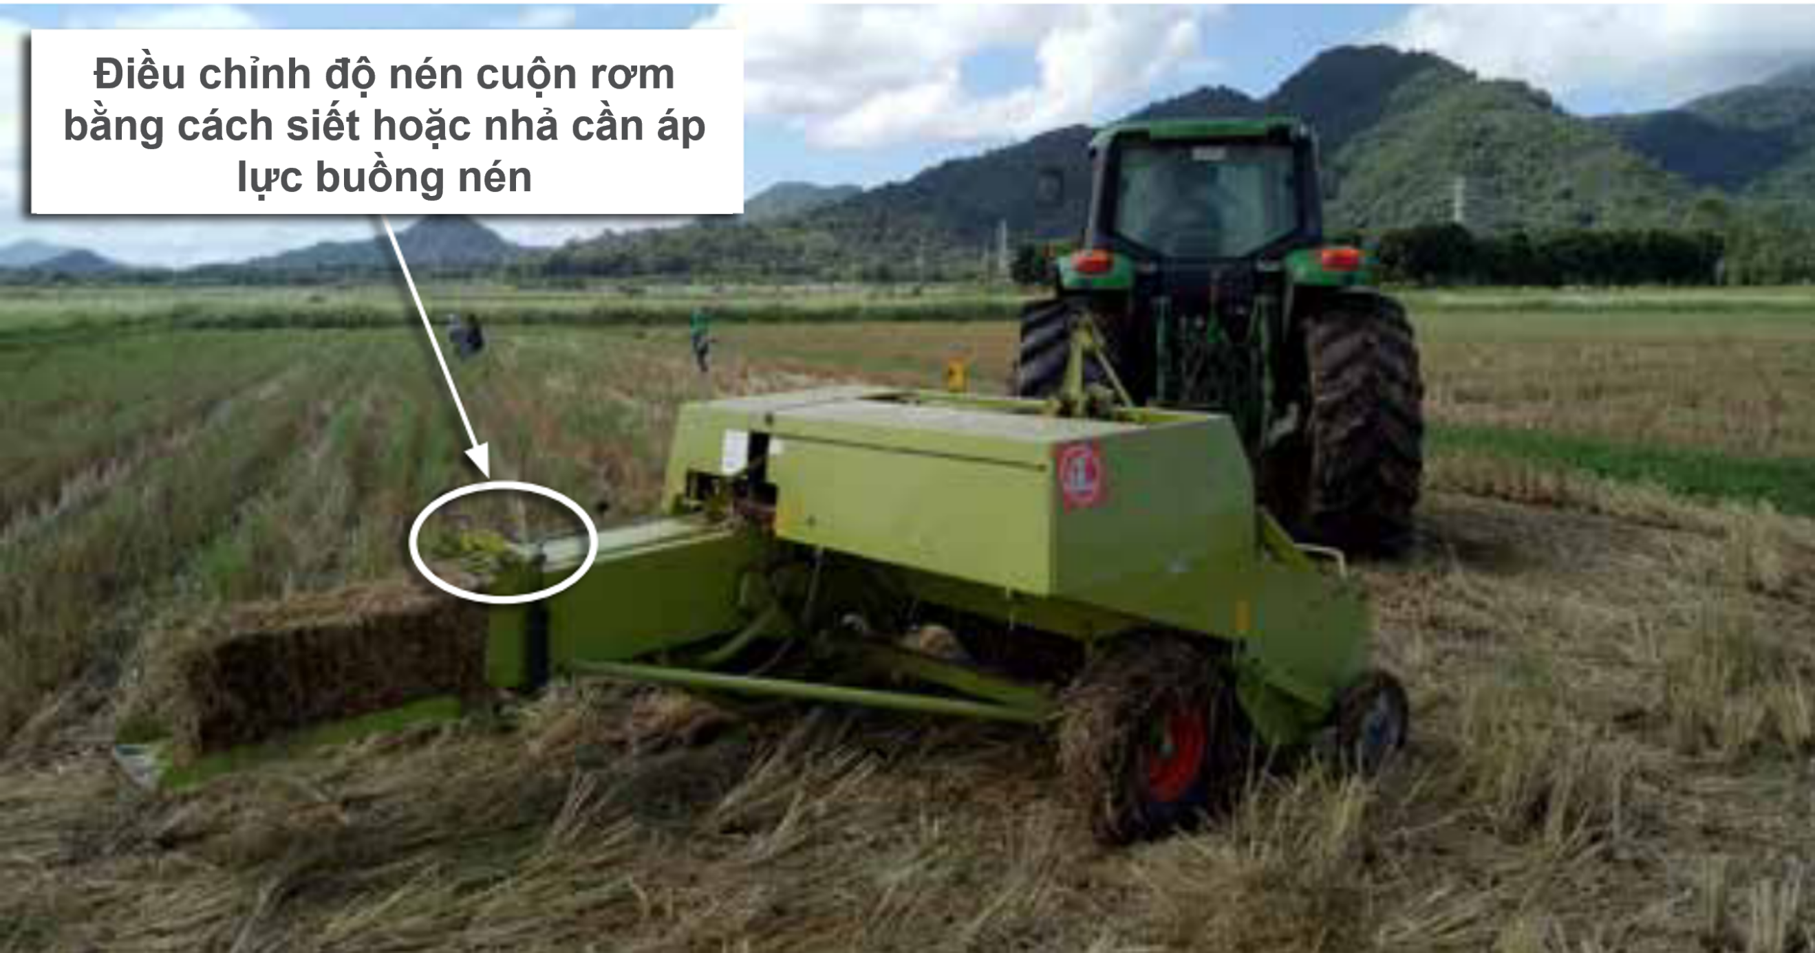
Square baler
Adjust the density of the straw bale by tightening or loosening the pressure compacting chamber.
Continuously compressing straw in the compacting chamber and ejecting the compacted bales without needing to stop

Slide 5
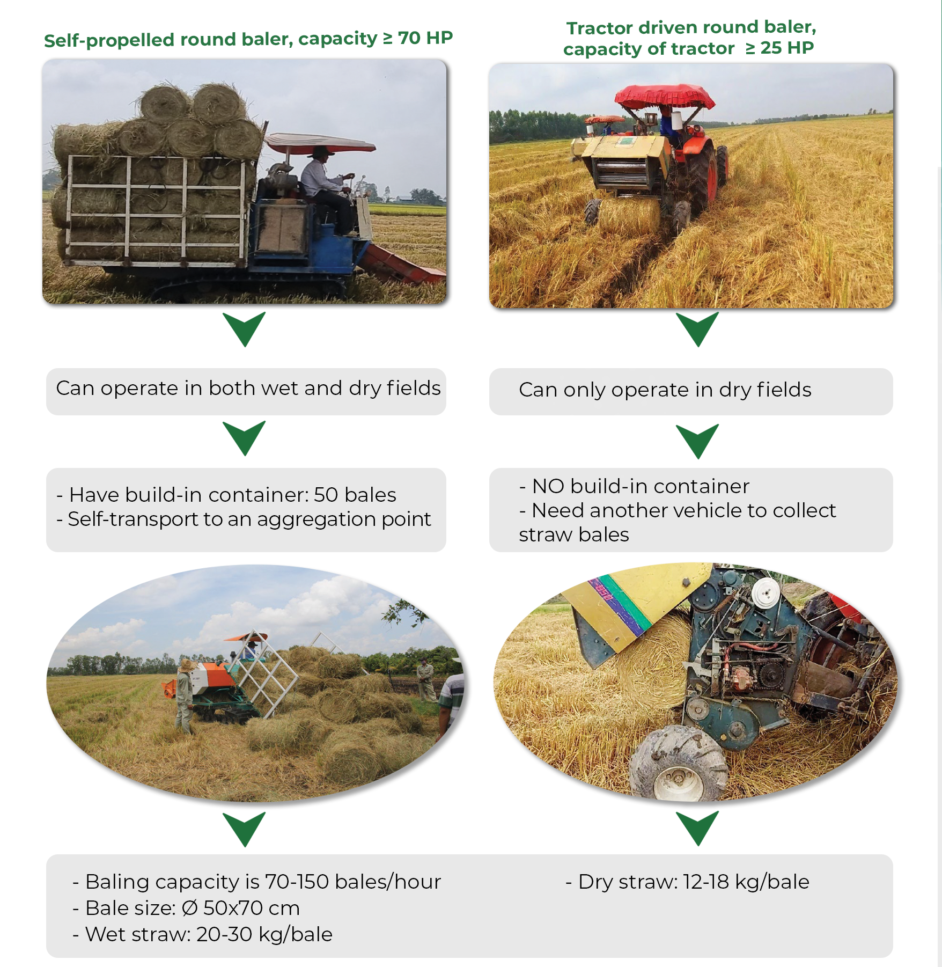
Popular balers in Vietnam

Slide 6
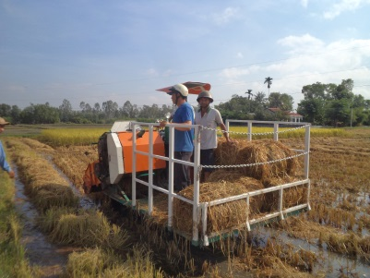
Popular balers in Vietnam
Table 1. Technical specifications of two common types of hay balers in Vietnam
Technical specifications | Roller baler pulled by a tractor | Self-propelled baler
Operating condition | Dry field | Dry field and wet field
Type of baler | Round | Round
Dimension of the bale (length x diameter), m | 0.7 x 0.45 | 0.7 x 0.45
The weight of the bale at 14% moisture content (kg/bale) | 18 – 20 | 18 – 20 (dry rice straw: 30 kg)
Yield (ton/hour) | 1.6 – 1.8 | 1 – 1.3
Investment cost (machine price)_2023 (million VNĐ) | 70 – 120 | 350
Capacity (HP) | 30 – 60 | 70 – 100
Fuel consumption (liters/ton) | 2.8 – 3 | 4 – 5

Slide 7
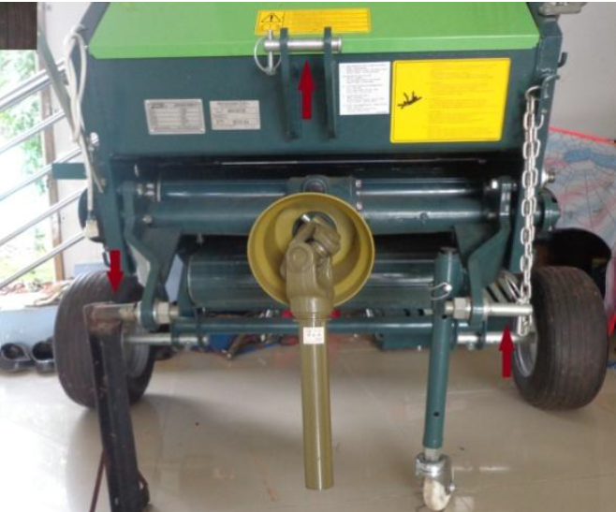
3. Operation the rice straw baler
Roller baler pulled by a tractor
The tractor power is measured in horsepower (HP) and is selected based on the size or type of hay baler. Therefore, a small baler (STAR MRB 0850B) and a medium-sized baling press (CLAAS Markant 55) will be used as examples
The three-point hitch of the baler is used to connect to the fixed attachment point on the left, the adjustable point on the right, and the upper attachment point.“

Slide 8
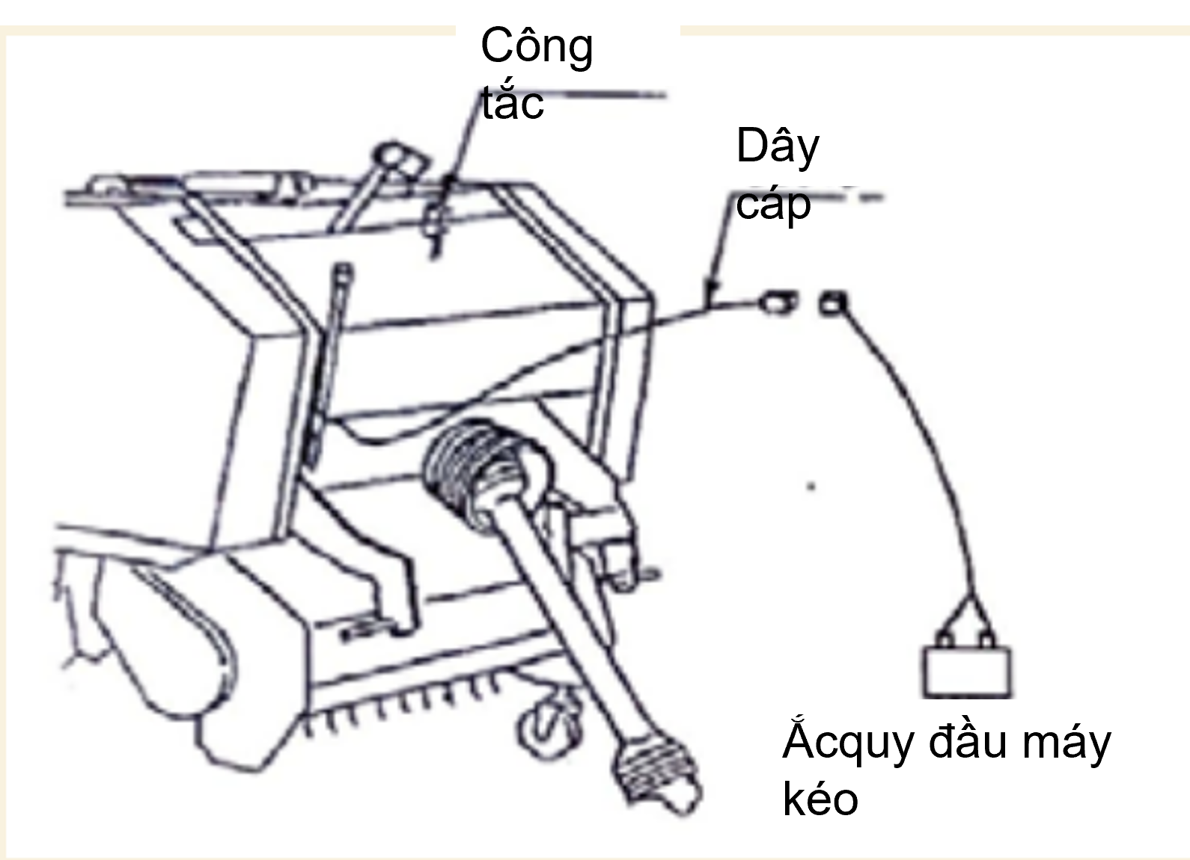
3. Operation the rice straw baler
Roller baler pulled by a tractor
Switch
Cable
the tractor's battery
Install the cardan joint onto the power take-off (PTO) shaft of the tractor. The cardan joint is located at the front of the baler, connecting to the tractor's PTO shaft
Diagram illustrating the simplified connection of the signaling mechanism (horn).
Connect the electrical wire from the signaling mechanism to the tractor's battery (12V).Place the signaling mechanism in an appropriate position for operating the machine.

Slide 9
3. Operation the rice straw baler
Roller baler pulled by a tractor
The STAR MRB 0850B is installed on the tractor and is ready to operate. The baler can start functioning once the three-point hitch is connected to the the power take-off shaft

Slide 10
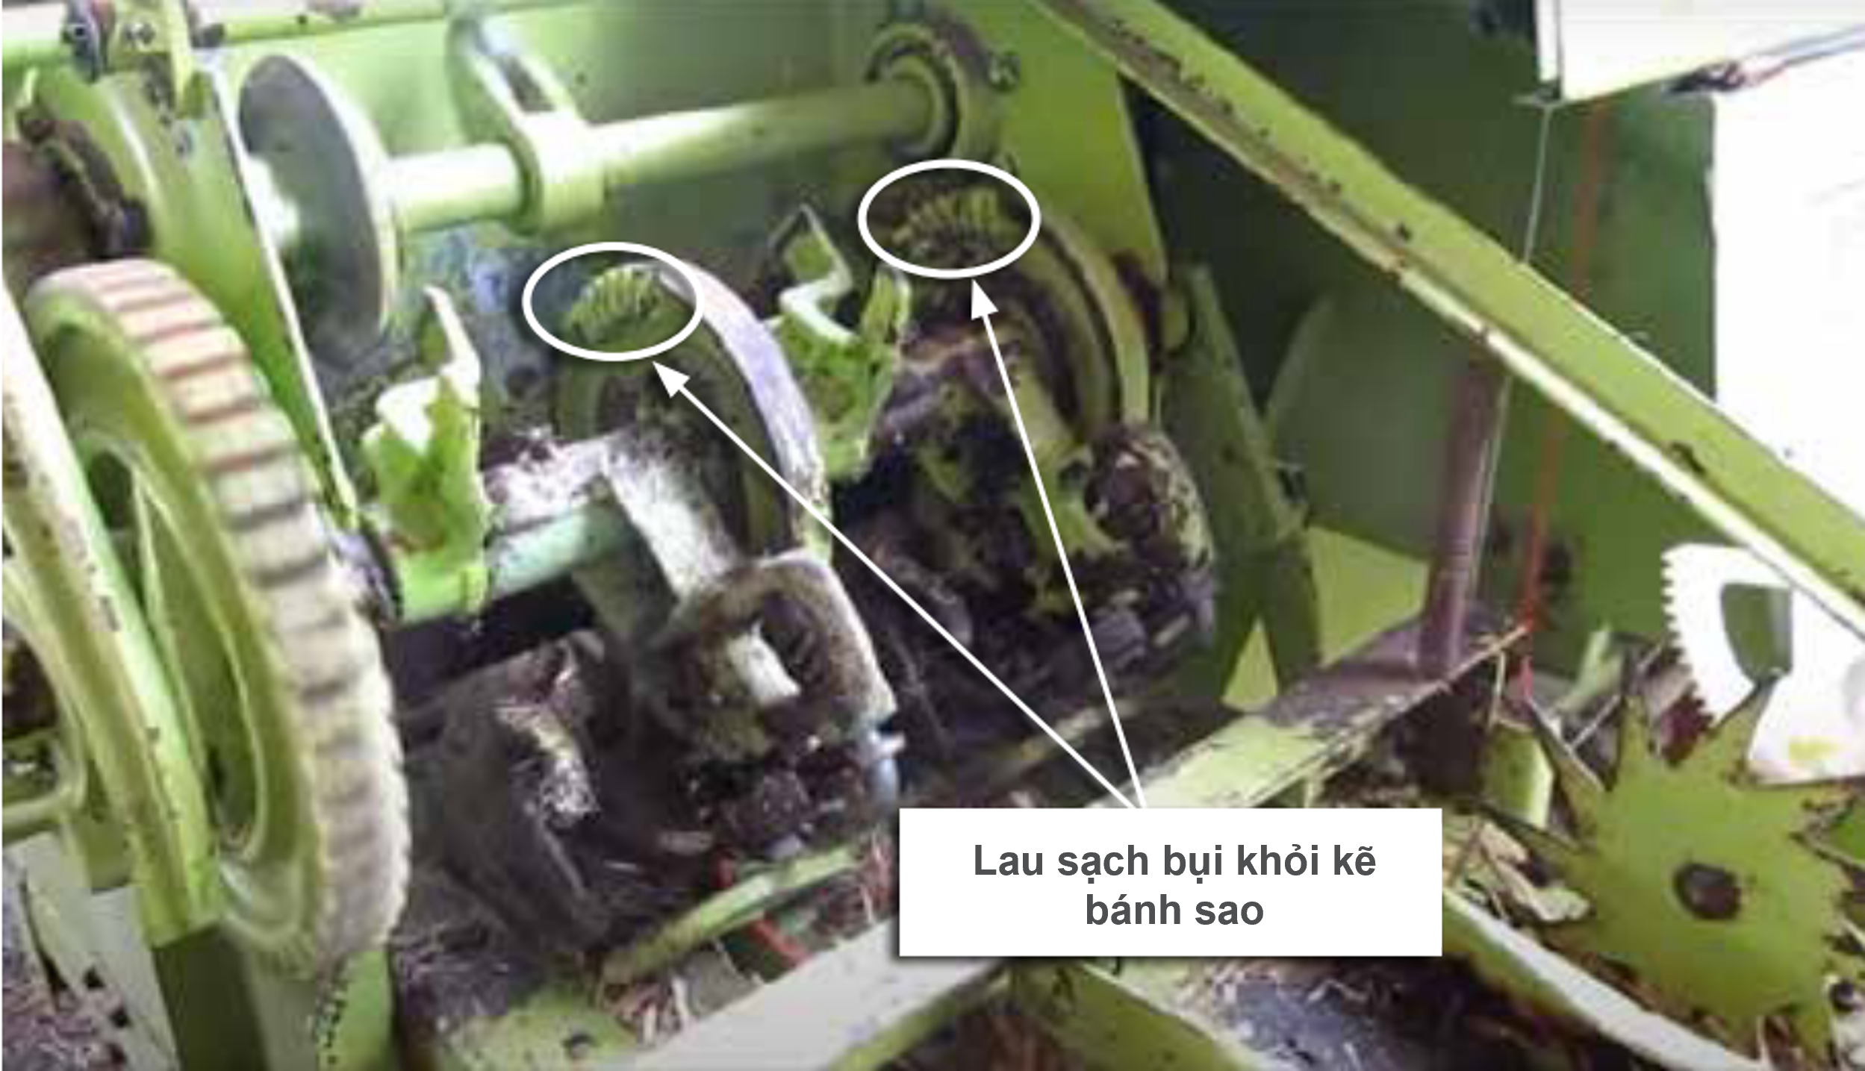
3. Operation the rice straw baler
Installing the CLAAS Markant 55 baler onto the tractor
Before installing the baler onto the tractor, ensure the gaps between the tines of the baling system are clean and lubricate all moving parts. Additionally, check if the tension of the chain and the baling rollers is appropriate, adjust the tension if necessary, and regularly inspect and lubricate the oil.
Clean dust off the rear wheel rim

Slide 11
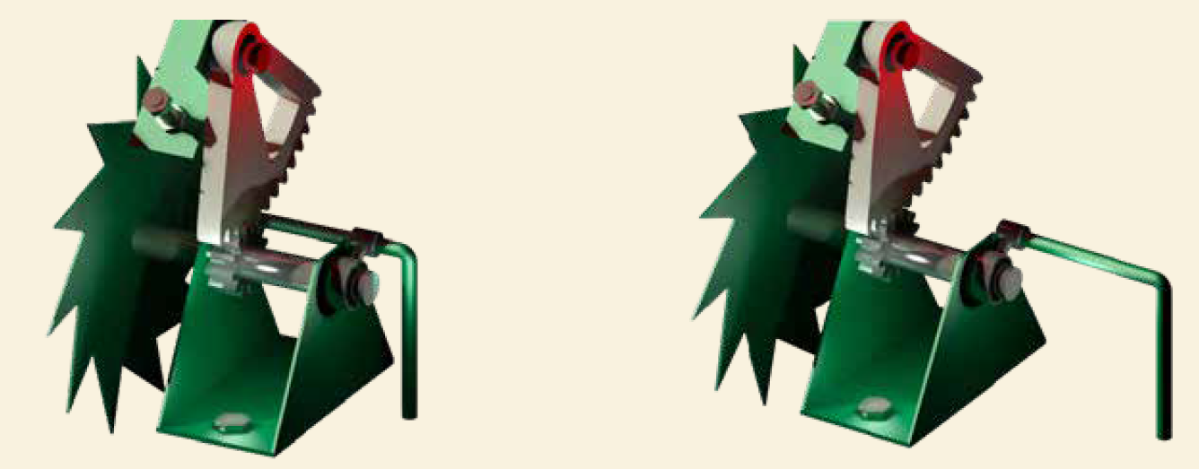
3. Operation the rice straw baler
Installing the CLAAS Markant 55 baler onto the tractor
Use a tractor with sufficient horsepower (minimum 60 HP) to pull the baler.
Install the baler onto the tractor and use the locking pin R to securely fix the hitch pin to the quarter-angle and the anti-roll bar.
Next, connect the baler’ cardan to the tractor's power take-off shaft and engage the compacting chamber.
Ensure that the components of the cardan are cleaned and lubricated before reassembly.
Before threading the twine, push the safety lock of the twine threading system towards the cut-off mechanism.
Lock the knot tightening mechanism in the OFF position when threading the rope.
Lock the knot tightening mechanism in the ON position during operation

Slide 12
3. Operation the rice straw baler
Installing the CLAAS Markant 55 baler onto the tractor
Install 6 twine spools into the compartment and tie the end of the outer spool to the inner end of the next spool to ensure continuous pulling of twine.
Adjust the knotter mechanism from transport mode to working mode.
Position the right-side stopper of the baler so that the operator can simultaneously pull the twine and slowly drive the tractor forward until the locking pin engages into the inner hole of the quarter-angle.
Adjust the baling height so that the tines are 20-30 mm above the ground.
Adjust the baling density according to the condition of the straw in the field.
Adjust the density of the straw bale by tightening or loosening the pressure compacting chamber.

Slide 13
3. Operation the rice straw baler
Checking the machine before operation and maintenance.
Check the machine before use: water, oil, lubricants, air (tires), and other factors.

Slide 14
3. Operation the rice straw baler
Safely start and stop the tractor
Before starting the tractor, the operator must understand the procedures and safe stop methods.
Once the work in the field is completed, or when the tractor needs to stop for repairs or inspection, safely stop the machine following these steps:
Turn off the engine.
Remove the key.
Apply the parking brake
Ensure that all control systems and equipment are set to safe levels.
In case it's not possible to stop at a safe point, appropriate contingency plans should be prepared.
Before starting the engine, ensure the working conditions are completely safe. Verify the braking system, steering, and other control systems. Additionally, ensure during operation that the tractor does not pose any danger to those nearby.

Slide 15
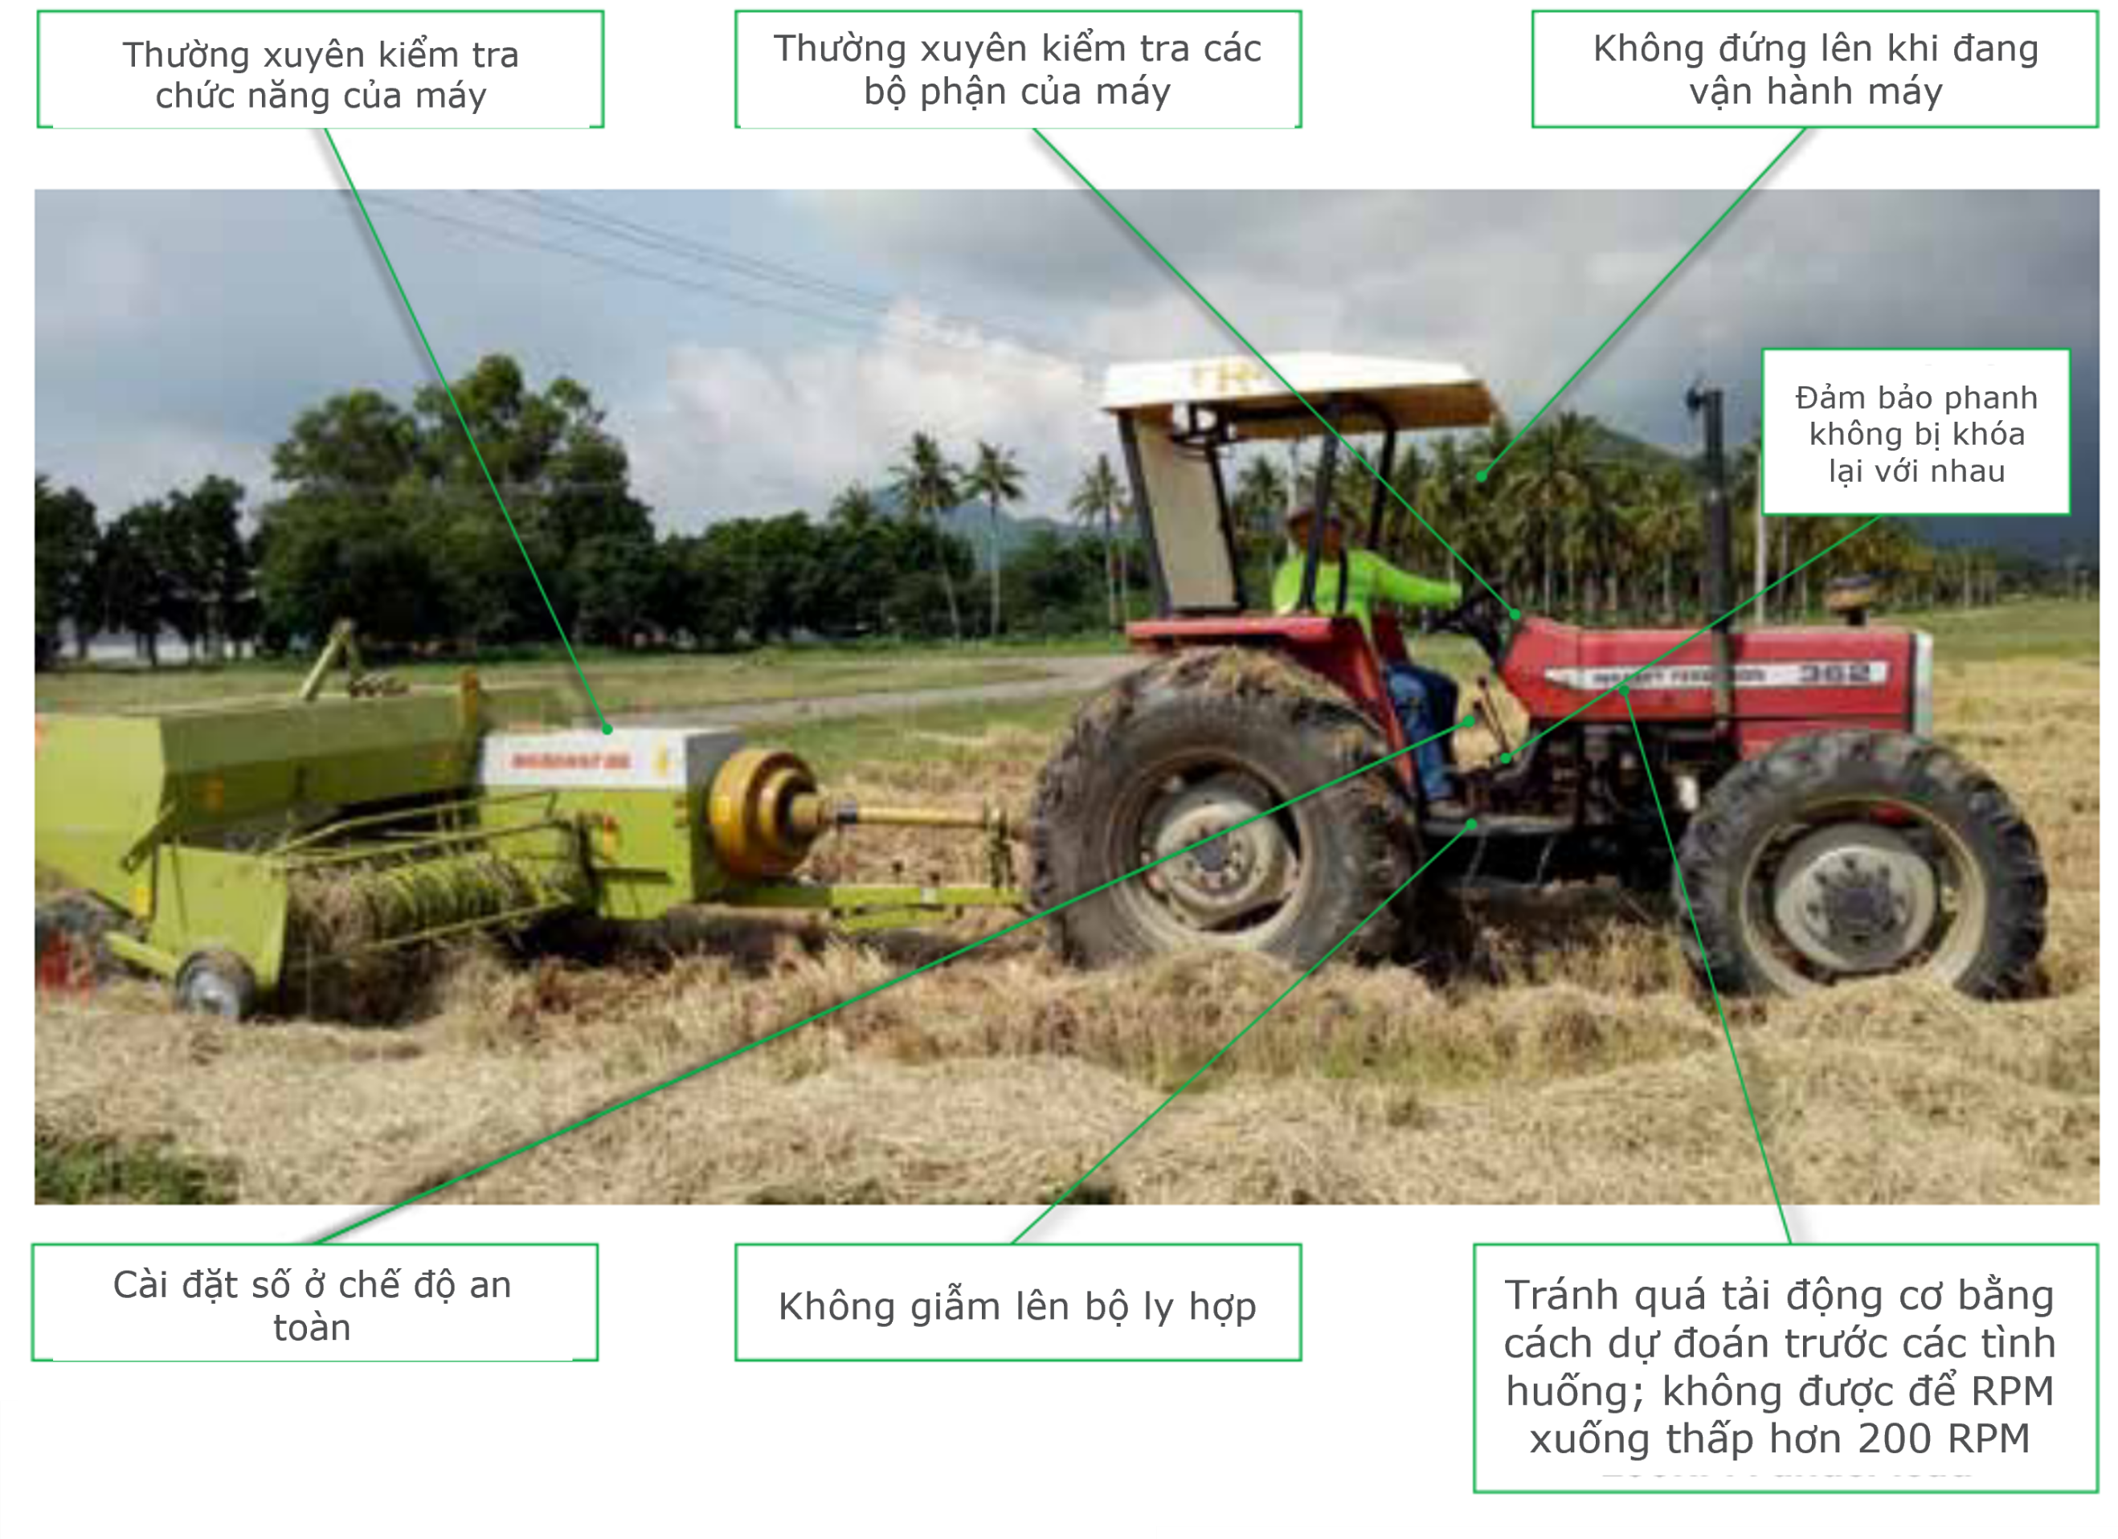
3. Operation the rice straw baler
Operating in the field
Regularly check the functionality of the machine.
Regularly inspect the machine components
Do not stand up while operating the machine
Ensure the brakes are not locked together
Set the gear to safe mode
Do not step on the clutch pedal
Avoid overloading the engine by anticipating situations in advance; do not allow the RPM to drop below 200 RPM
Some safety considerations for operating a tractor in the field

Slide 16
4. Troubleshooting and maintenance
Guidelines for performing basic maintenance procedures
Timing of execution | Parts to be checked | Troubleshooting methods
After 1 hour of initial operation | The tightness of nuts and bolts. The slack of the chain | Tighten nuts, bolts, chains, and compression springs to the specified torque in the manual.
Before/After operation | Tire pressure and tightness of nuts and bolts | Maintain tire pressure at the recommended level (195 kPa). Tighten nuts and bolts
 | Wear of hay pick-up fingers, cutting knives, self-cutting bolts | Replace worn-out parts
 | Lubrication of rotating and moving parts | Lubricate as recommended with recommended lubricating oils
When not in use | Damaged parts | Repair, replace
 | Worn-out or missing parts (such as pins, screws, self-cutting bolts, etc.) | Replace
 | Debris, dirt | Clean the pickup reel and compression chamber if not used for a long period

Slide 17
4. Troubleshooting and maintenance
Basic Troubleshooting Guide
Incident | Common Causes | Solution
Unusual noise during operation | Broken impeller arm, discharge rotor, or thrust bearing | Replace broken parts
 | Entangled straw or twine | Remove dust and tangled pieces
 | Loose V-belt | Adjust the tension of the V-belt according to the instructions
Straw is not collected at all | The collection mode is set incorrectly | Adjust collection height according to instructions
 | Machine moving speed is too fast | Reduce travel speed/operate machine at recommended speed
Straw gets stuck between the collecting arm and the compacting chamber | Broken impeller arm | Replace broken parts
 | The power collector shaft rotates too fast | Adjust the power pickup shaft settings according to the instructions
 | Side panels and shields are stuck | Remove the side panels and shields
 | Machine moving speed is too fast | Reduce travel speed
 | The groove is too wide and too high | Create grooves with dimensions as shown in the instructions
 | The tilt of the straw reel is too large | Shorten the connecting rod so that the machine tilts slightly forward

Slide 18
4. Troubleshooting and maintenance
Basic Troubleshooting Guide
Incident | Common Causes | Solution
The straw reel does not rotate | The V belt is too tight or too loose | Adjust the tension of the V-belt according to the instructions
 | The V belt is broken | Replace new belt
 | The impeller arm is too high compare with the field | Adjust collection height according to instructions
 | The groove is too wide and too high | Create grooves with dimensions as shown in the instructions
 | Side panels and shields are stuck | Remove the side panels and shield
The roller makes a strange noise | Straw and mud get stuck in the roll | Eliminate stuck agents
 | Not enough lubrication | Lubricate the rolling chain
 | Roller chain is loose | Adjust roller chain tension according to the instructions
 | The roller is chipped | Replace
Straw gets stuck in the roller | The power collector shaft rotates too fast | Adjust the power pickup shaft settings according to the instructions
 | Straw gets stuck in the reel | Remove the stuck straw from the reel
 | The roller is chipped | Replace
The roller chain is hot | Compacting is too tight | Adjust the compacting and support plate according to the instructions
 | Not enough lubrication | Lubricate the rolling chain
 | Roller chain is loose | Adjust roller chain tension according to the instructions

Slide 19
4. Troubleshooting and maintenance
Basic Troubleshooting Guide
Incident | Common Causes | Solution
Rolled straw does not have enough compacting | The bale is compacted too tightly because the signaling mechanism is not working | Adjust/install the signaling mechanism according to the instructions
 | Installed the wrong bale size for the backing plate | Install the back plate according to the instructions
The signaling mechanism does not make a sound | The signaling mechanism is disabled | Turn on the signaling mechanism
 | The battery is out of power | Replace the battery (9V laminated battery; 6F22);
 | Incorrect cable connection | Connect the correct cable
 | The lever is too far away from the tie arm | Adjust the lever position
The straw ball is not tied with rope | The binding is not in the correct position | Adjust the rope according to the instructions
 | Not enough lubrication | Lubricate according to instructions
 | The compacting spring is installed incorrectly | Adjust the compression spring according to the instructions
 | The rope falls off the pulley | Adjust the rope
 | The rope is tangled | Remove tangled knots
 | The left bale does not have enough compacting | Gather enough straw for the left side of the machine
 | Provide that the wire does not lift up after leaving the hinge | Lubricate and adjust the lowering speed with a pair of nuts. Adjust the lowering speed of the rope feed lever so that it does not lower faster than the rope
 | The end of the rope is not inserted into the compacting chamber | Remove the obstruction and insert the end of the rope into the compacting chamber. Clean machine parts

Slide 20
4. Troubleshooting and maintenance
Basic Troubleshooting Guide
Incident | Common Causes | Solution
The bundling unit operates before the bale reaches sufficient tightness | The rope is in the wrong place | Adjust the rope according to the instructions
 | The rope is longer than usual because the rope cutter is worn out | Replace the cutter and adjust the rope length according to the instructions
The rope was caught in the bale of straw | The rope does not have enough knots | Adjust the number of knots according to the instructions
The cutting rope is not sharp | The rope is loose | Tighten the fastener plate's glue nut one to two turns
The bale of straw is not released | The straw is compressed too tightly | Adjust compacting according to instructions
 | The groove is too wide | Create grooves according to instructions
 | The field surface is sloping | Release straw bale on flat surfaces
The compacting chamber door does not open | Stop valve is closed | Open the stop valve
 | The hydraulic circuit is broken or damaged | Check and repair the hydraulic door opening and closing system according to instructions
 | Wrong clasp installed | Adjust the support plate according to the instructions
 | The power receiver shaft connector is loose | Reinstall the power take-up shaft and release the bale while the power take-up shaft is operating
 | The power supply does not have enough oil | Lubricate according to instructions and use recommended lubricant

